Slide 1
Accelerating Information Technology Innovation
http://aiti.mit.edu
Ghana Summer 2013
Django Lecture 6 – Forms
Notes:
<number>

Slide 2
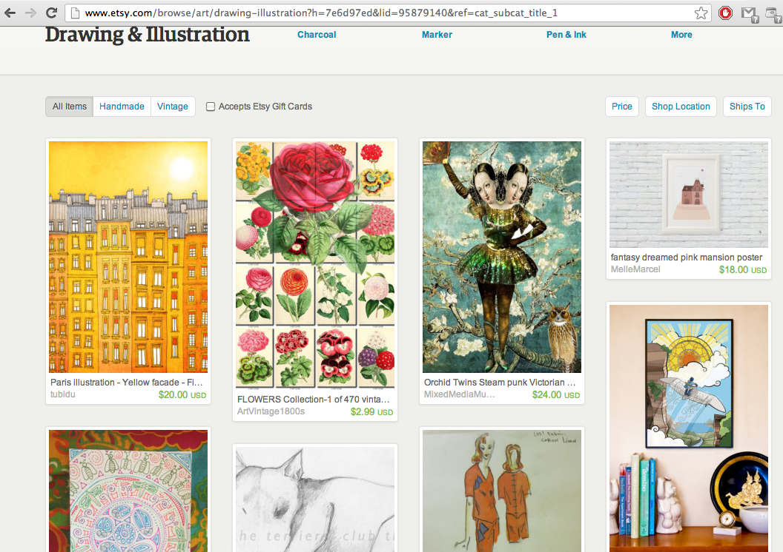
Art-selling website
<number>

Slide 3
Art-selling website
class Artwork(models.Model):
title = models.CharField(max_length=100)
artist = models.CharField(max_length=100)
description = models.TextField()
created = models.DateTime()
<number>

Slide 4
How can sellers submit their artwork?
You don’t want to give users access to the admin interface, but you still want them to be able to add/update data
<number>

Slide 5
Form
<number>

Slide 6
Forms in Django
localhost:8000/submit
urls.py
Template
Models
View
Artwork
Get data from form and put it in the database
<number>

Slide 7
Basic HTML form
<html>
<head>
<title>Submit your artwork</title>
</head>
<body>
<h1>Submit your artwork</h1>
<form action="/submit_art/" method="post">
<p>Title: <input type="text" name=”title"></p>
<p>Your name: <input type="text" name=”name"></p>
<p>Description: <textarea name=”description" rows="10" cols="50"></textarea></p>
<input type="submit" value="Submit">
</form>
</body>
</html>
<number>

Slide 8
Basic HTML form
<form action="/submit_art/" method="post">
<p>Title: <input type="text" name=”title"></p>
<p>Your name: <input type="text" name=”name"></p>
<p>Description: <textarea name=”description”> </textarea></p>
<input type="submit" value="Submit">
</form>
<number>

Slide 9
Form
<number>

Slide 10
Django Form
from django import forms
class SubmissionForm(forms.Form):
title = forms.CharField(max_length=100)
name = forms.CharField(max_length=100)
description = forms.CharField(widget= forms.Textarea )
<number>

Slide 11
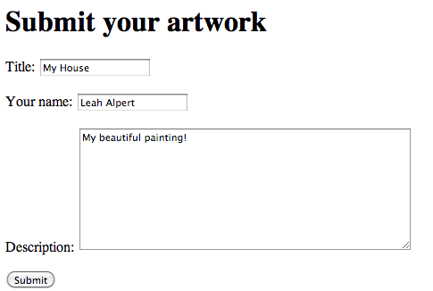
Filling out a form
<number>

Slide 12
Getting form data
When someone presses “Submit”, the browser sends the data from the form to the view as a dictionary
{’title': ’My House',
’name': ’Leah Alpert',
’description': ’My beautiful painting!'})
You can access this dictionary in the view with request.POST
<number>

Slide 13
Form validation
f.is_valid()
Returns true if all values passed to the form are valid
<number>

Slide 14
cleaned_data
f.cleaned_data
Returns a dictionary with all data from form
{’title': ’My House',
’name': ’Leah Alpert',
’description': ’My beautiful painting!'})
class SubmissionForm(forms.Form):
title = forms.CharField(max_length=100)
name = forms.CharField(max_length=100)
description = forms.CharField(widget= forms.Textarea )
<number>

Slide 15
Form Error Handling
Error handling is done automatically by the form and errors are saved into an instance variable called errors
<number>

Slide 16
Forms in Django
localhost:8000/submit
urls.py
Template
Models
View
Artwork
Get data from form and put it in the database
<number>

Slide 17
Creating a view
Check if form has been submitted
Check if form is filled out correctly
Get data from form
Create a new object using form data
localhost:8000/submit
urls.py
Template
Models
View
Get data from form and put it in the database
Artwork
<number>

Slide 18
Creating a view
Check if form has been submitted
if request.method == 'POST’:
Check if form is filled out correctly
if form.is_valid():
Get data from form
form.cleaned_data
Create a new object using form data
Artwork(title=title, desc=desc…)
<number>

Slide 19
Creating a view
def contact(request):
if request.method == 'POST':
form = SubmissionForm(request.POST)
if form.is_valid():
title = form.cleaned_data[’title'],
desc = form.cleaned_data[’description'],
name = form.cleaned_data[‘name’]
now = datetime.now()
artwork = Artwork(title=title, description=desc, name=name, created=now)
artwork.save()
return HttpResponseRedirect('/contact/thanks/')
else:
form = ContactForm()
return HttpResponse()
<number>

Slide 20
New submission_form.html
<html>
<head>
<title>Submit your artwork</title>
</head>
<body>
<h1>Submit your artwork here</h1>
<form action="" method="post">
{{ form }}
<input type="submit" value="Submit">
</form>
</body>
</html>
<number>

Slide 21
Lab
Add form to add comments
<number>

