Slide 1
HTML and CSS

Slide 2
HTML
Hyper Text Markup Language
Tells browser how to display text and images

Slide 3
Tags
Each text item goes within opening and closing tags
<p> text goes here </p>

Slide 4
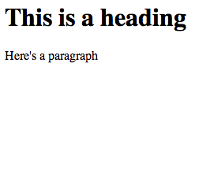
Example
<h1>This is a heading</h1>
<p>Here’s a paragraph</p>

Slide 5
Basic HTML page – html and body tags
<html>
<body>
<h1>My heading</h1>
<p>This is a paragraph</p>
</body>
</html>

Slide 6
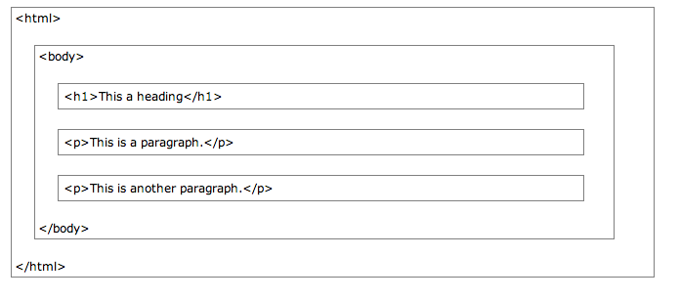
Page structure

Slide 7
HTML tags

Slide 8
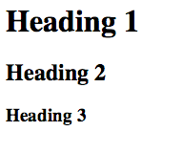
Headers
<h1>Heading 1</h1>
<h2>Heading 2</h2>
<h3>Heading 3</h3>

Slide 9
Link
<a href=“google.com”>
Google</a>

Slide 10
Image
<img src=image/url.jpg>

Slide 11
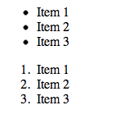
Lists – Ordered and Unordered
<ul>
<li>Item 1</li>
<li>Item 2</li>
<li>Item 3</li>
</ul>
<ol>
<li>Item 1</li>
<li>Item 2</li>
<li>Item 3</li>
</ol>

Slide 12
HTML head
<!DOCTYPE html>
<html>
<head>
<title>Title of the document</title>
</head>
<body>
The content of the document
</body>
</html>

Slide 13
CSS
Cascading style sheets
Define how the HTML elements look
style.css
body {
background-color: #d0e4fe;
}
p {
color: blue;
background-color: yellow;
}

Slide 14
Connecting HTML and CSS
<!DOCTYPE html>
<html>
<head>
<title>Title of the document</title>
<link rel="stylesheet" type="text/css" href="style.css">
</head>
<body>
The content of the document
</body>
</html>

Slide 15
Syntax

Slide 16
Properties: background
background-color: #ff0000;
background-image: url(‘www.image.jpg’);

Slide 17
Properties: text
color: blue;
font-family: “Times New Roman”, Times, serif;
font-family: “Arial”, sans-serif;
font-size: 40px;
text-align: center;

Slide 18
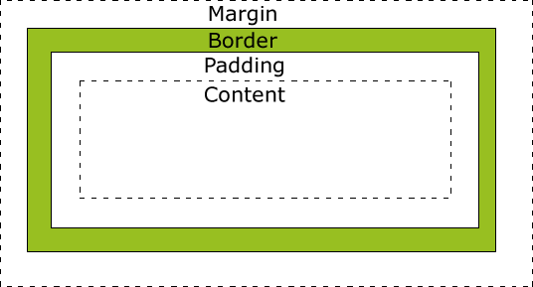
Box Model

Slide 19
Properties: box model/sizing
width: 200px;
padding: 10px;
margin: 4px;
margin-left: 20px;
margin-right: 10px;
margin-top: 10px;
margin-bottom: 0px;
border: 1px solid blue;
border: 2px dashed green;

Slide 20
Selectors
Which HTML elements does this CSS apply to?

Slide 21
Selectors: type
Selects all elements of that type
HTML:
<ul>
<li> one </li>
<li> two </li>
</ul>
CSS:
li {
color:blue;
}

Slide 22
Selectors: id
Only one element can have a given id
HTML: <div id=“name”>…</div>
CSS:
#name {
color:blue;
}

Slide 23
Selectors: class
Multiple elements can have the same class
Elements can have multiple classes
HTML:
<div class=“alert”>…</div>
<div class=“alert warning” >…</div>
<div class = “alert” id=“name”>…</div>
CSS:
.alert {
color:red;
font-size:14px;
}

Slide 24
Lab: HTML and CSS
Make 2 HTML pages: homepage and blog post page
Draw ideas on back of lab
See me if you haven’t finished Friday’s lab

