Slide 1
Developing for the Windows Ecosystem
Dave Russell
Technical Evangelist
Microsoft

Slide 2
Agenda
Design concepts
  New look and feel
  Windows 8
  Windows Phone 8
Azure
Development Models
  HTML
  DirectX
  XAML
Development Languages
  C#, HTML, VB, C++
Windows 8 Features
Windows Phone Features
Store

Slide 3
Trends
Touch
Connected
Consumerization of IT
Social
Cloud/Services
Notes:
Start the conversation about how things have changed with application development and platforms.
Talk about the more natural interfaces
Always connected
Social media
Consumerisation of IT
Cloud based computing

Slide 4
Devices & Services

Slide 5
DEVICES

Slide 6
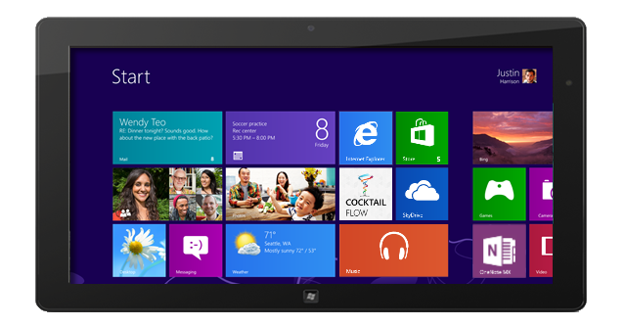
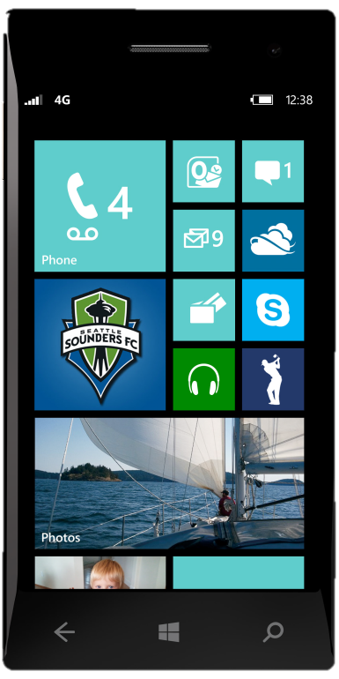
Consistent experience

Slide 7
Windows 8
Overview - Demo

Slide 8
Windows Phone 8
Overview - Demo

Slide 9
Platform Investments
WinRT
Consistent user experience
Windows & Windows Phone Store
Portable Libraries

Slide 10
Win8 and WinPhone 8 Apps
Desktop Apps
View
XAML
HTML /CSS
HTML Javascript
C C++
C#
VB
Model
C
C++
C#
VB
Javascript
System Services
WinRT APIs
Communication & Data
Graphics & Media
Devices & Printing
Internet Explorer
Win32
.Net / SL
Application Model
Core
Windows Core OS Services

Slide 11
WP8 Subset of Win8
Networking
Proximity
In-App Purchase
Sensors
Location
File System
Core app model
Threading
Full WinRT
11,000 members
Windows Phone Runtime
2,800 shared members
600 new members

Slide 12
cv
Services

Slide 13




Cloud Design Principles
always up.
always on.
economics
usage based
automated
elastic
managed
Notes:
To explain WHY CLOUD, we need to understand the design principles of Cloud Computing. At a very fundamental level, this entire concept is one of SHARING RESOURCES. If we could share effectively, we could STOP the waste of resources - all those computers running workloads/applications that are on all the time, cost lots of money, require highly paid staff to babysit them and most of which are using 20-30% of the compute capacity dedicated to them.
This is true if you want to share better within your own data center (so called Private Cloud), or you share with other companies or even countries (Public Cloud).

Slide 14
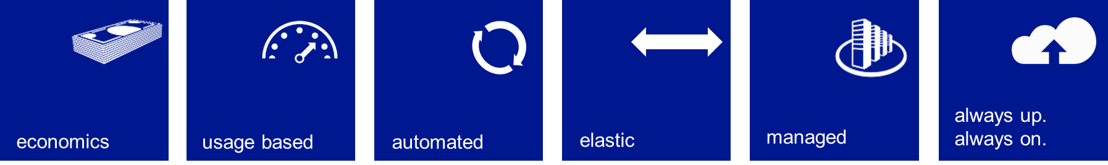
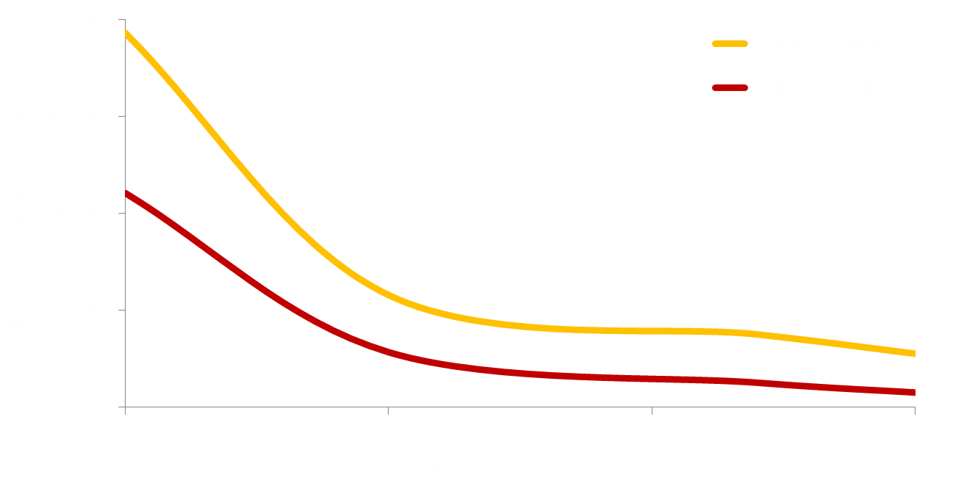


Economics of the Cloud
Private vs Public Clouds
SMB: >25x public cloud benefit
Enterprise: ~10x public cloud benefit
Public cloud steady state pricing
Source: Microsoft
Notes:
The first piece if the puzzle if Economics. As this chart indicates, the larger the data center, the cheaper the underling TCO is. This is primarily because if you walk to your local power company and say I need to buy a billion gigaflops of power, you get a cheaper price. If you walk across to HP or Dell and say I’d like to but a $billion worth of computers – you get a good deal.
Not only that, but to run at this scale you have to automate almost everything and this automation makes the TCO cheaper because people are expensive. You can only afford to do this if you are very large – it is a big investment in software.
The smaller you are of course the bigger the difference in the economics.

Slide 15
Computing Patterns
Inactivity
Period
Compute
t
On and Off
Growing Fast
Unpredictable Bursting
Predictable Bursting
24x7 Steady
Capacity Needed (Max + 20%)
Save
20-30%
Capacity Needed (Max + 20%)
Save
60-80%
S M T W T F S
J F M A M J J A S O N D
On and Off
(30%)
Growing Fast
(15%)
Unpredictable Bursting
(25%)
Predictable Bursting
(20%)
24x7 Steady
(10%)
Your Application Portfolio – What Does it Look Like..?
Notes:
One dimension of Cloud computing then is the aggregation of resources to share. One large pool at a cost it would be very hard for most even very large organizations to match.
Another dimension of the economics equation made possible in the Cloud is to optimize the resources you consume. In traditional IT, resources like compute power, disk storage, database capacity are constained – it is hard to get them quickly and it is hard to change them.
Because of the automation and software/programmable nature of everything we do in the Cloud – YOU have the ability to match the demand/supply of computing resources more closely than in the traditional model.
Explain the 5 patterns – in 4 out of the 5 patterns – if you could match supply with demand more closely – you would save money.
In the traditional model, we do a lot of work to establish what resources we need. Capacity planning, performance testing, scale testing etc so that we can make sure for a particular application, we always have enough of the resources we need. We go and buy the hardware and software and then implement all this technology and leave it there hoping we never need to change. Instead of the resource line being flat and all that waste – if we can get the resource line close to the demand line, we can save 20-30% in a given week for this sort of pattern…
Imaging though a pattern, as many organization have, of an application that has this sort of demand curve spread over a year (click)
Finally – you have to think about these potential savings across your whole application portfolio… The only group you won’t get much saving from is the steady state – but you will generally find this represents a small proportion of your portfolio
Getting close to the demand line for an application is achieved in the Cloud because of the characteristics of the cloud being usage based, automated and elastic. This means that you only pay for the resources when they are being used, it is easy and quick and you can automate changing your usage at any time and even based on policy through capabilities such as auto-scaling, and of course you can do this both directions to easily add resources or remove them.

Slide 16
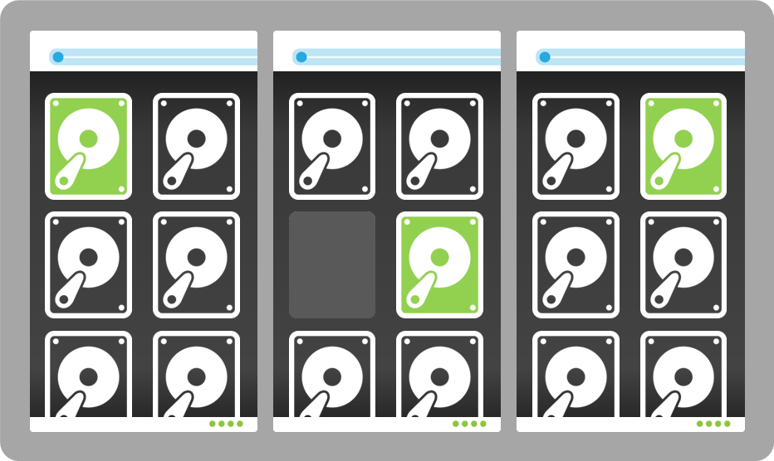
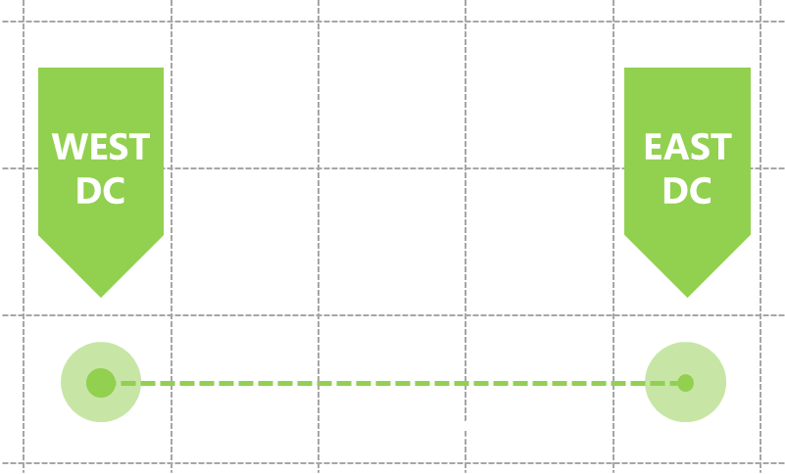
Resilience and Scale
Everything is designed to Fail… because resources are plentiful
Multiple instances of applications and application services
Instances provide BOTH scale and resilience
Instances and no resource constraints make change and deployments easy
Anything can fail but apps/services continue to work
The platform monitors, manages and recovers from failures
An Example: Windows Azure Storage
Notes:
There is an underlying principle at play here in the Cloud – which is that because as we have seen resources are cheap, plentiful and immediately available, different approaches can be taken to build applications the way we always wanted to – focus on the business problems using simple approaches.
At the heart of this is the concept in your applications that anything, any part of the app can fail. You can for example have your web server tier fail and the application can keep working. How you do this is by having multiple instances of your web tier, many copies. Any of the copies can fail – the platform makes sure that it can detect and recover from these failure simply by spinning up a new instance. The platform also needs to make sure that your application instances are separated across redundant parts of the underlying physical infrastructure (in Azure we call these fault domains).
Use the Azure storage as an example. You give a file to Azure – it saves that file 3 times in 3 different fault domains. If any of the copies of the file fail because maybe a disk failed, the platform creates another copy. The platform can also (and this happens in Azure by default) copy the file another three times to Azure storage in a data center > 500 miles away (in the same region) proving business continuity/DR capabilities.

Slide 17





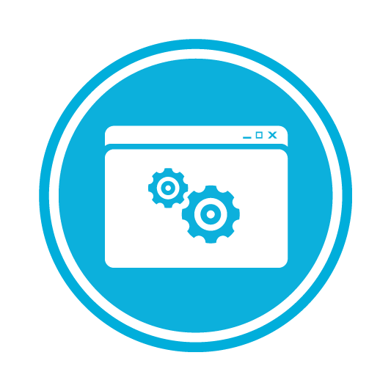

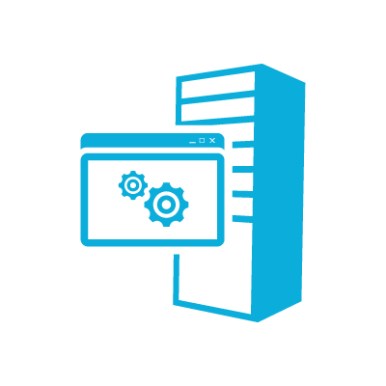
Microsoft Differentiation
open
hybrid
hybrid
Windows
Azure
Other Service
Providers
the cloud
usage based
automated
managed
on your terms
flexible
New
always up.
always on.
+
elastic
economics
Existing
Your Data Center
STORAGE
NETWORKING
BUSINESS
INTELLIGENCE
DATA
API
COMPUTE
Notes:
Let’s just pause and understand what we have said so far…
The cloud design principles (6 boxes on the left) are what we all want, but these are the core principles of ANY cloud provider.
We have talked about the spectrum of choices and that as you look across your application portfolio, you will need to run applications across this spectrum. More importantly, not just applications but business processes themselves span this spectrum and extent outside your organization boundaries to your customers and partners
So what makes Microsoft’s approach different:-
Explain the three boxes. We are the only company who has the strategy to do this. Support existing app models as well as “designed for the cloud” models. Have a Cloud OS – the underlying infrastructure that supports the cloud design principles on the left, available to you in your own data center, as a service we provide in Windows Azure or to other partners you may choose. Finally, your choices around development tools, languages, frameworks should just work, whatever you choose (but we will of course make .NET the first and best experience).
- Finally, we have a comprehensive and deep range of supporting application services (the band at the bottom) that are delivered across this platform. Many of these services are iterations of the work we have been doing in our server and tools business. This is innovation and learning from 20 years of enterprise software development we are evolving into our products.

Slide 18


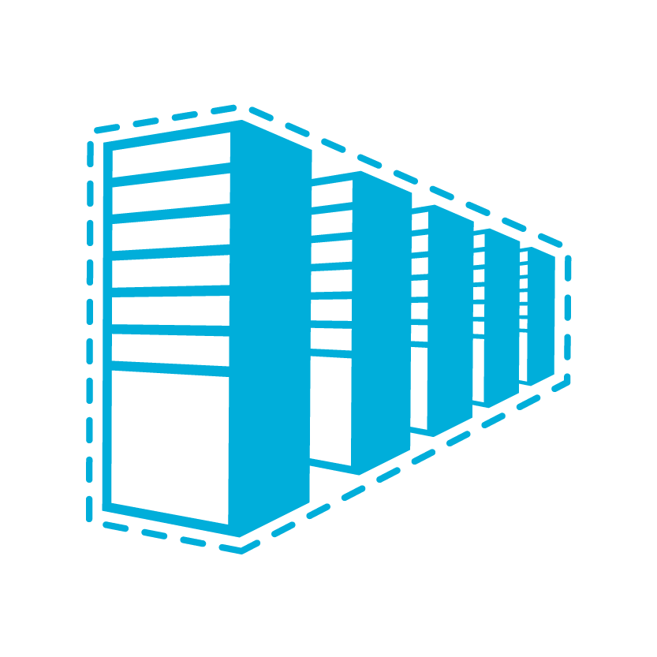













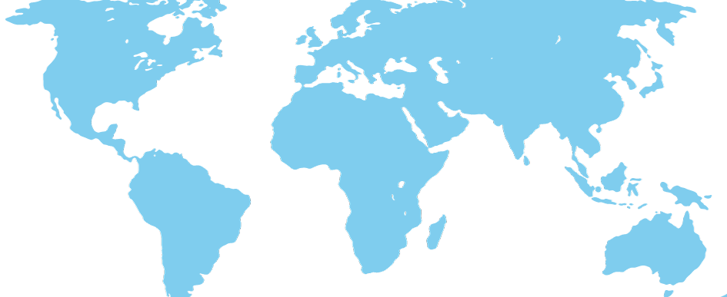
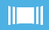


caching
identity
service bus
media
cdn
integration
hpc
analytics
app services
virtual machines
web sites
cloud services
mobile services
SQL database
HDInsight
tables
blob storage
connect
virtual network
traffic manager
compute
data services
networks
Global Physical Infrastructure
servers / network / datacenters
Automated
Managed Resources
Elastic
Usage Based
N Central US, S Central US, N Europe, W Europe, E Asia, SE Asia + 24 Edge CDN Locations
Notes:
So this picture, or at least the big blocks in here are how we think about the main capability buckets of the platform. Now you will start to get more specific about these buckets (Compute, data, networks and app services).
Going deeper will depend on the needs of the customer. Sometimes customers will want to drill into specific things, sometimes they want a broad overview. Adapt these slides as needed.
These buckets correspond to how they are laid out in the Windows Azure portal.

Slide 19

Windows Azure Compute
Flexible IaaS and PaaS based hosting options for Cloud, Web, and Virtual Workloads.
  Features:
  99.95% Monthly SLA
  Support for Windows and Linux VM’s
  Fault Isolation
  Elastic Capacity
  Open source support (Git, etc…)
  First class .Net Support
  Support for a variety of languages and frameworks -
compute
Windows Azure Websites
WEB
Virtual Machines
VIRTUAL
CLOUD
Worker Role
Web Role
.net
node.js
Frameworks
java
php
python
Notes:
We established that the “container” or “execution environment” is critical in terms of having a number of options that provide the flexibility to get down to the underlying operating system if needed, especially to support existing applications, as well as to have more isolated/abstracted containers which then allow the platform to do more for you.
If you have time, the best way to do this, is to SHOW windows azure (see next hidden slide).
If not, don’t spend much time on this slide, the following slides on Web/Virtual/Cloud go into details.

Slide 20


Windows Azure Websites
A highly scalable Web hosting service for private and public clouds optimized for cloud hosting economics and integrated with the worlds best applications, frameworks and tools.
Flexible
Open
Solid
Easy to get started with 10 free web sites
Easy to create sites in a few clicks
Easy to deploy existing sites
Easy to manage and scale your sites
Supports multiple frameworks (ASP.NET, Classic ASP, PHP, Node.js)
Pick from popular Open Source apps
Pick your DB (SQL Azure, MySQL)
Choose your tools
(Visual Studio, Git, FTP, WebMatrix)
Build on any platform
(Windows, Mac, Linux)
Nearly instant deployment
Scale out for greater availability or scale up for improved performance using our global cloud platform
Integrated source control with Team Foundation Server (TFS) and Git
Notes:
Assume you know how to talk about this – again the best way is to show it on the portal, show the scale tab and explain the different modes (Free, Shared, Reserved).

Slide 21
Windows Azure Virtual Machines
Infrastructure as a Service introduces new functionality that allows full control and management of both Windows and Linux virtual machines along with an extensive virtual networking offering.
Flexible
Open
Solid
Easily migrate existing applications as-is to the cloud
Assist New Cloud App Development by Integrating IaaS and PaaS Functionality
Set up new virtual machines in Windows Azure with only a few clicks.
Agentless Deployment for Windows Servers
Start from a pre-built image from our image library
Upload your own VHD from on-premises.
Create Your Own Customized Images
Support for community and commercial versions of Linux
Move images back on premise as necessary
Run enterprise applications such as SQL Server, SharePoint or Active Directory in the cloud
Easily create hybrid cloud and on-premises solutions with VPN connectivity between the Windows Azure Data Center and your own network.
Notes:
Key point is – It’s just a Virtual Machine, a container for any software (OS all the way up) you want to run in it. You pay for the underlying resources you are reserving (CPU and RAM). These VM’s (using Virtual Networking) can be private to your corporate network – they can see your corporate AD etc.) Even though they live in the public cloud you can surround and protect them so they are just part of your own infrastructure.

Slide 22


Avoiding Lock-In
Windows Virtual machines can move freely between all 3 clouds.
Windows Azure
Other Service Providers
Windows
Virtual Machine
Customer Data Center
Notes:
In this slide the important thing to land is that our VM implementation is THE same as on-prem. Now we only do Hyper-V (there are 3rd Party tools and tools in system center that can convert between VMWare and Hyper-V), but it is simple to take existing Hyper-V images and move to the cloud, to other hosters who host Hyper-V or Windows Azure – and of course you can move them back as well.
NOTE: YOU cannot do this with AWS – you are locked in.

Slide 23

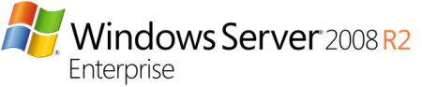

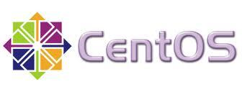
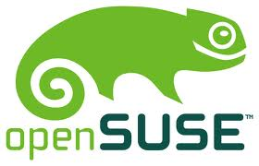

Flexibility of Azure Virtual Machines
Multiple ways to get started…
Variety of images to select…
Persisted
in Storage…
Management Portal
Boot VM from New Disk
Server
>_
Blob Storage
Scripting
(Windows, Linux and Mac)
Cloud
REST API
Notes:
Talk though the three pillars – the first one is really about automation, then we don’t just do Windows, we do other OS’s and apps on top. The actual VM image is of course a .VHD file that has to live on a disk somewhere. We take advantage of the underlying resilience and speed of the Azure Storage infrastructure to store these disks which provides

Slide 24
Cloud Services
Unlimited Scale
Two Flavors:
A place for your application code to run…
Web role is simply a Virtual Machine
with IIS pre-configured
Worker role is for non-web based processing code, back-end business processes
You package your code/artifacts and deploy
Azure bootstraps a VM, installs the code
and starts up the VM for you. Load balances multiple instances and manages all OS patching and instance resilience and lifecycle
Web Role
Worker Role

Slide 25

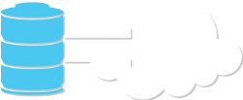
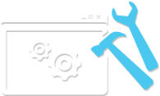
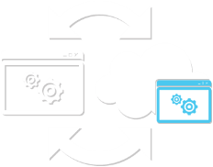
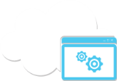
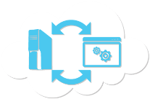
SQL Server and Azure SQL Database
Public Cloud
Delivery Options
SQL Server in a Windows Azure Virtual Machine
Windows Azure SQL Database
(Formerly SQL Azure Database)
Move Existing Tier 2 & 3 Apps
Develop
& Test
Backup Database to the Cloud
Extend
On-Prem Apps to Windows Azure VM
Develop New
Cloud-Designed Apps
Extend On-Prem Apps
to Windows Azure
SQL Database
KEY SCENARIOS
Use both SQL Server in Windows Azure VM and Windows Azure SQL Database in a single app.
Notes:
At this point we covered compute. Remember our key building blocks (Compute, Data Services, Networking and Application Services). Outside of compute (which is special in that this is where your custom code and business logic runs), all these other capabilities in the platform are things that your applications just use. Of course, any given app won’t use all of these services, most will just use a few. The point is that we have a tremendously complete platform.
Check if the BRIEFING also has a SQLAzure topic (which will usually follow the Windows Azure topic) – if so, just cover this very lightly
Most apps though do need to store/deal with structured data – typically that would live in a database.
There are two flavors we are going to talk about – SQLServer in a VM and Azure SQLDB. This is also a good proxy/illustration that makes things very real between the differences of IaaS and PaaS and how all the value and promise of the Cloud is delivered through PaaS (and just some of it through IaaS).

Slide 26

Azure SQL DB - How It Works
Architecture
Client Layer
PHP
SQL Server
Applications
and Tools
WCF Data Services
  Client Layer - Used by application to communicate directly with SQL Database.
  Services Layer – Gateway between Client layer and Platform layer.
  Platform Layer – Includes physical servicers and services that support the Services layer.
  Infrastructure Layer – IT administration of the physical HW and OS.
ODBC
ADO.NET
Tabular Data Stream (TDS)
TDS+SSL
Services Layer
Provisioning
Provisioning
Provisioning
…
Billing and Metering
Billing and Metering
Billing and Metering
…
S
Fault Domain #1
Web Site
Azure SQL DB
Connection Routing
Connection Routing
Connection Routing
…
P
Fault Domain #2
Platform Layer
SQL Server
SQL Server
SQL Server
…
S
Fault Domain #3
SQL Database Fabric
SQL Database Fabric
SQL Database Fabric
…
Management Services
Management Services
Management Services
…
Infrastructure Layer
Notes:
Of course Azure SQL DB is somewhere under the covers, SQLServer. This picture illustrates where SQLServer actually lives. Of course there are a number of services build around this that really add value to the picture and deliver those cloud principles (Scale, Elasticity, Self-Service, Resilience etc.). You don’t need to explain all the layers – the point is they are there and actually that in “traditional” IT world, many/most of these functions in the picture are done by people, by IT Pro’s and DBA’s, worrying about how to get dtaabases proivisioned, keep the running, change them, fix them when broken etc.
Click: The other interesting thing about this picture is that when you provision a DB for your app (which you can do in about 6 seconds), the app actually get’s three “virtual” databases and one logical database that it interacts with (click). Each of the three database is located within Windows Azure in Fault Domains – a unit of computers all with redundant hardware, racks, switches etc. There is a “Primary” and two secondaries. Windows Azure is responsible for all the consistency and integrity of the three databases and completely automated will recover from failures and ensure balance of primaries and secondaries across physical nodes.
All you need to do is provision a database, say how big you want it, upload your schema and data, then start using it. EVERYTHING else is taken care of for you. AND you only pay for the actual data you are storing in the database (calculated on a daily basis).
Contrast this picture against doing your own thing in Azure Virtual Machines with SQLServer (or any other database for that matter) AND of course having to provide the same level of resilience.

Slide 27






Windows Azure Services
tables
identity
NoSQL capabilities for apps
ISO 27001 certified
Auto scale to meet volumes of up to 100tb
Integrate with enterprise identity
Enable single sign-on within your apps
Enterprise Graph REST API
93% of Fortune 1000 use Active Directory
blob storage
service bus
Highly available, scalable and secure
Blobs can be exposed publically over http
Continuous geo-replication
Secure messaging and relay capabilities
Easily build hybrid apps
Enable loosely coupled solutions
Notifications Hub for devices
caching
media
Low latency, in-memory distributed cache
Dynamically grow and shrink cache size
High availability support
Memcached protocol support
Create, manage and distribute content
Target any device or media format
Ingest, Encode, Protect, Stream

Slide 28





Windows Azure Services
HDInsight
cdn
Enterprise-ready Hadoop distribution.
Familiar tools such as Excel, PowerPivot, SQL Server Analysis Services and Reporting Services.
Easily add edge caching to your app
Cache content at locations closest to your customers
Integrated with Blob storage
traffic
analytics
Intelligent policy engine for DNS queries
load balance incoming traffic
Improve performance and availability
SQL Server business analytics on VM’s
Data marketplace
Reporting services
StreamInsight
networking
integration
Provision and manage VPN’s
Establish machine-to-machine connections
General purpose data validation, transformation and routing
Specific EDI and B2B engines

Slide 29
Azure
Dashboard – Demo & Mobile Services and building your first app

Slide 30
Wrap up
Easy to develop for Windows 8 or Phone or Azure
Great looking applications
Easy scalability
Store

Slide 31




Who’s Who?
Dave Russell
Windows Phone
drussell@microsoft.com
Ahmed Salijee
Application Lifecycle Management
ahmeds@microsoft.com
Jarrod Hermer
Windows 8
jhermer@microsoft.com
Kath Roderick
Windows 8
kathero@microsoft.com

Slide 32



Who’s Who?
Morgan Webb
Infrastructure & IT Pro
morganwe@microsoft.com
Gareth Jane
Azure
gjane@microsoft.com
Cliff de Wit
DPE Director
cdewit@microsoft.com

