Slide 1
Rumah TahfidzQu a social enterpreneur
Team One

Slide 2
Profile
Name : M. Suyitno
Age : 28
Product Line (Mainly f&b)
a. Chips
b. Ice cream
c. Caterer
Also as independent book publisher
Annual gross revenue about 1 billion rupiah (approximately 100.000 USD)
Starting his business since 2 years ago.

Slide 3
Startups
Motivation
To be useful for others

Slide 4
Vision and Mission
Vision
Becoming a successful social entrepreneur
Mission
Business diversification that is useful for mankind
Care for children education
Preaching while doing business

Slide 5
Business attitude
Risks taker
Overconfidence
Good Ethics
Philanthropic
Good networking
Crazy
Trustworthy

Slide 6
Marketing Technique
Words of mouth
Guerilla Radio
Exhibition
Stores Consignee

Slide 7
Philanthropy Acts
Children Al Quran Education Center
50% of profit for social action
Islamic boarding house

Slide 8
Competitive advantage
Religious market
Healthy and organic products
Supporting local farmers

Slide 9
Future business line
Mineral Water
Minimarkets
Islamic schools

Slide 10
Biggest challenges and advices
challenges
Physical disability
Advices
Be brave

Slide 11
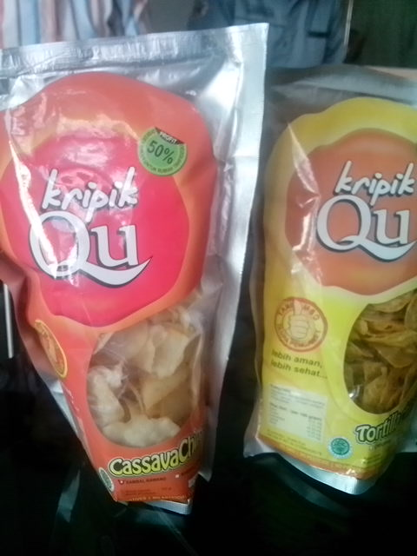
Main Product

Slide 12
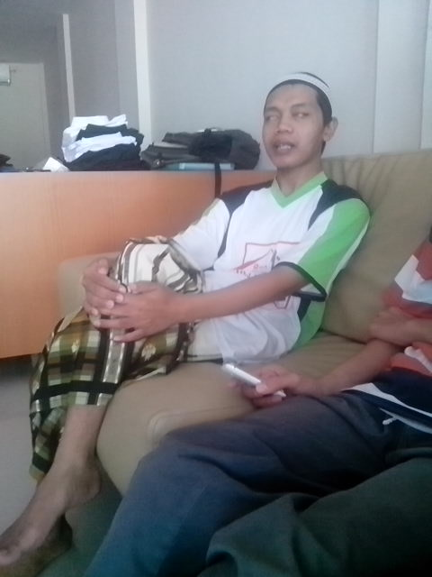

Slide 13
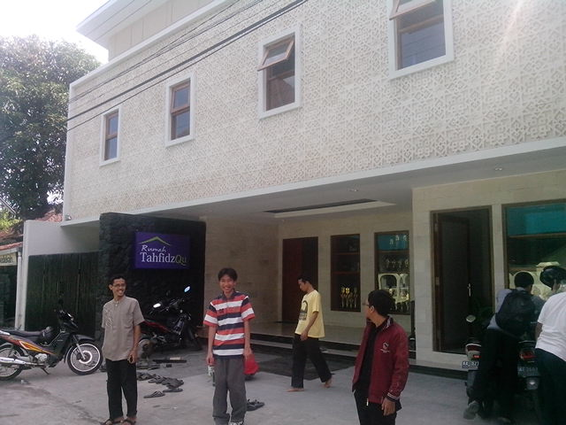

Slide 14
